Slide 1
Getting the Most out of SharePoint Patterns & Practices
Chris Kent
Office 365 Practice Lead, DMI

Slide 3















“Me”
Indianapolis, IN
Office Development
Office 365 Practice Lead
@theChrisKent
Member of the Core Team
theChrisKent.com
Notes:
Can I possibly get my name on a single slide even more? Wow.

Slide 4
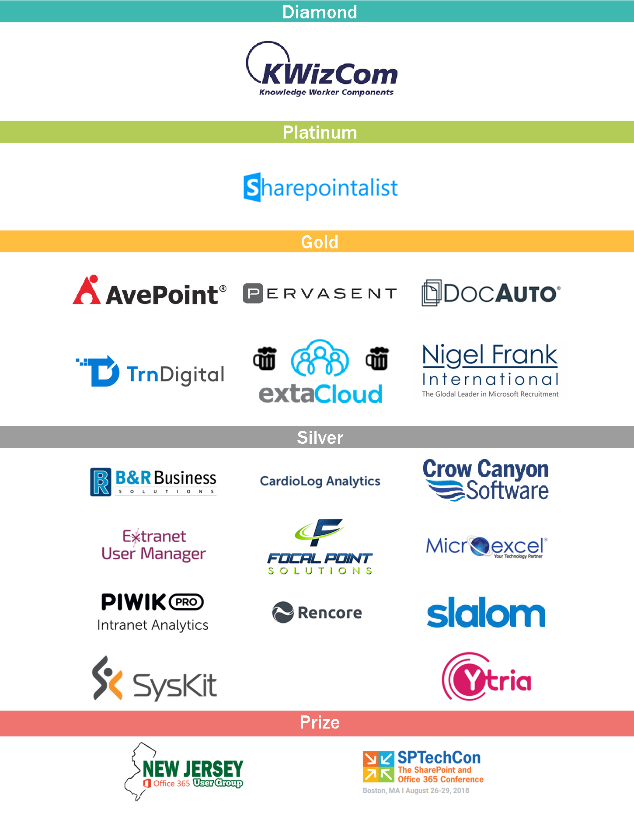
Thank You EVENT Sponsors
We appreciated you supporting the
New York SharePoint Community!
Diamond, Platinum, Gold, & Silver have tables scattered throughout
Please visit them and inquire about their products & services
To be eligible for prizes make sure to get your bingo card stamped by ALL sponsors
Raffle at the end of the day and you must be present to win!

Slide 5
Goals

Slide 6
Patterns & Practices
Why | What | How

Slide 7
Staying INFORMED
Videos | Calls | Updates

Slide 8
SHARING IS CARING
How to Contribute

Slide 9

2017
Deep Integration
SharePoint Dev Ecosystem = SharePoint PnP. End-to-end coordination of SharePoint development guidance and community activities.
2016
Partnership
PnP ownership moved to engineering as a partnership for aligning with the roadmap. Work with SPFx starts.
2015
Reusability
PnP Provisioning Engine, reusable components and solutions introduced. Weekly webcasts started.
2014
Going public
First CodePlex, then GitHub. Concentration on add-in model enterprise scenarios.
2013
Internal Initiative
Internal initiative within Microsoft to consolidate knowledge gained from the add-in model

Slide 10





Watch time in YouTube
185,811 minutes
Views in YouTube
31,522
Unique visitors in GitHub
42,946*
Views in GitHub
202,488*
High Level Statistics
June 2018
Views in docs.microsoft.com (SharePoint Dev)
860,293
Most used capability Provisioning Engine
(2956 tenants)
PnP Reusable Component usage
Unique tenants
13,316
Http Requests
10.4 Billion
High level statistics for the SharePoint Developer Ecosystem: Usage and community behavior across SharePoint Online, YouTube, and GitHub.
*avg over 2 weeks

Slide 11


Slide 12
























CORE TEAM
Radi Atanassov
@RadiAtanassov
Stefan Bauer
@StfBauer
Andrew Connell
@andrewconnell
Erwin van Hunen
@erwinvanhunen
Australia
Austria
USA
Sweden
Bert Jansen
@O365Bert
Vesa Juvonen
@vesajuvonen
Chris Kent
@theChrisKent
Andrew Koltyakov
@AndrewKoltyakov
Waldek Mastykarz
@waldekm
Belgium
Finland
USA
Russia
Netherlands
Paolo Pialorsi
@PaoloPia
Patrick Rodgers
@mediocrebowler
Elio Struyf
@eliostruyf
Mikael Svenson
@mikaelsvenson
You?
Italy
USA
Belgium
Norway

Slide 13

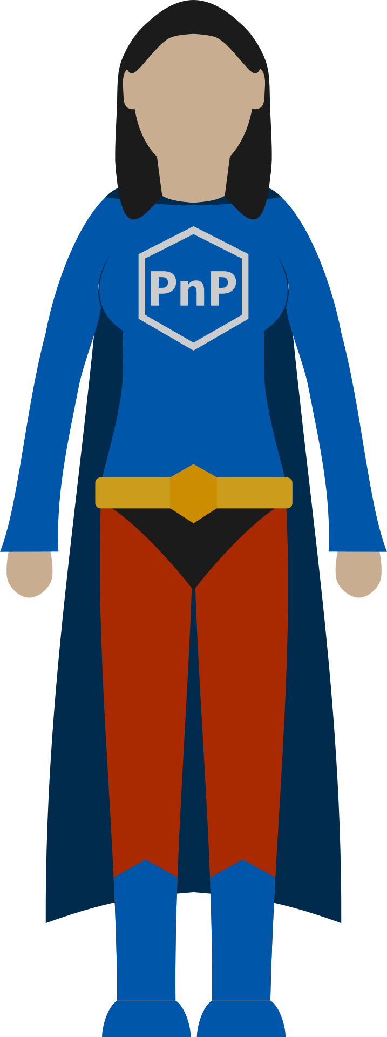
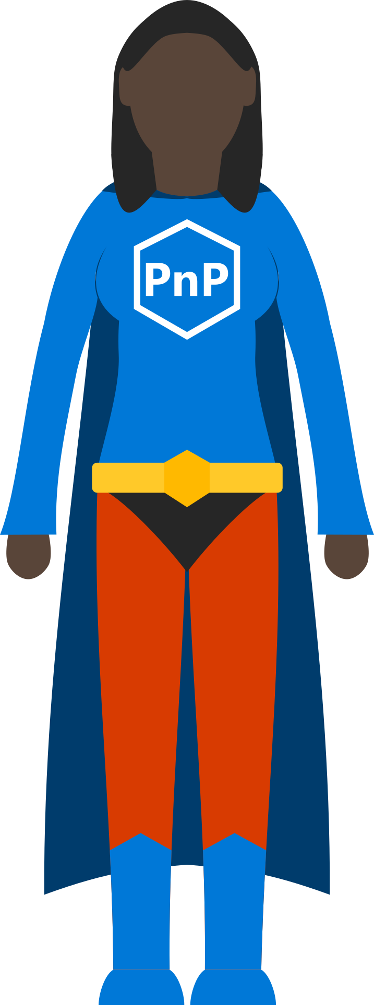
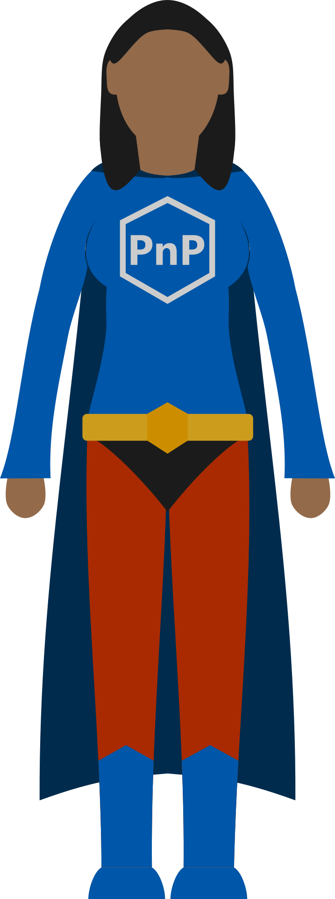
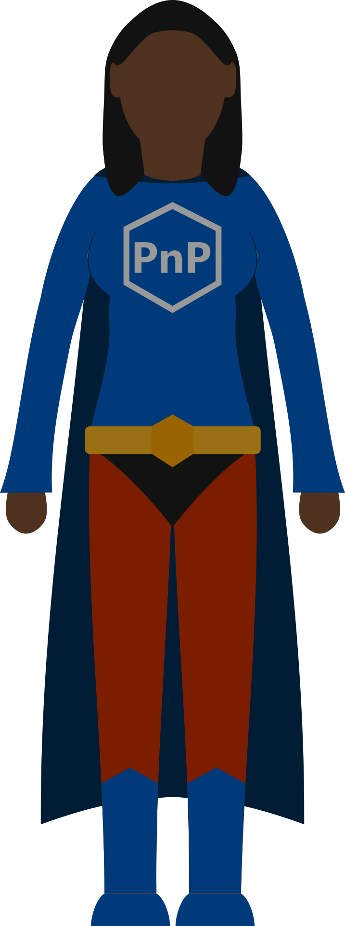
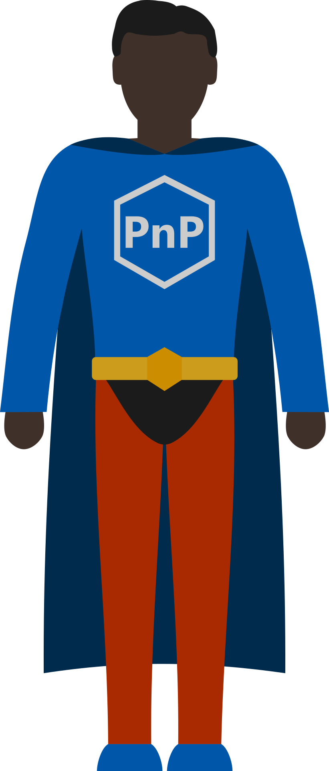
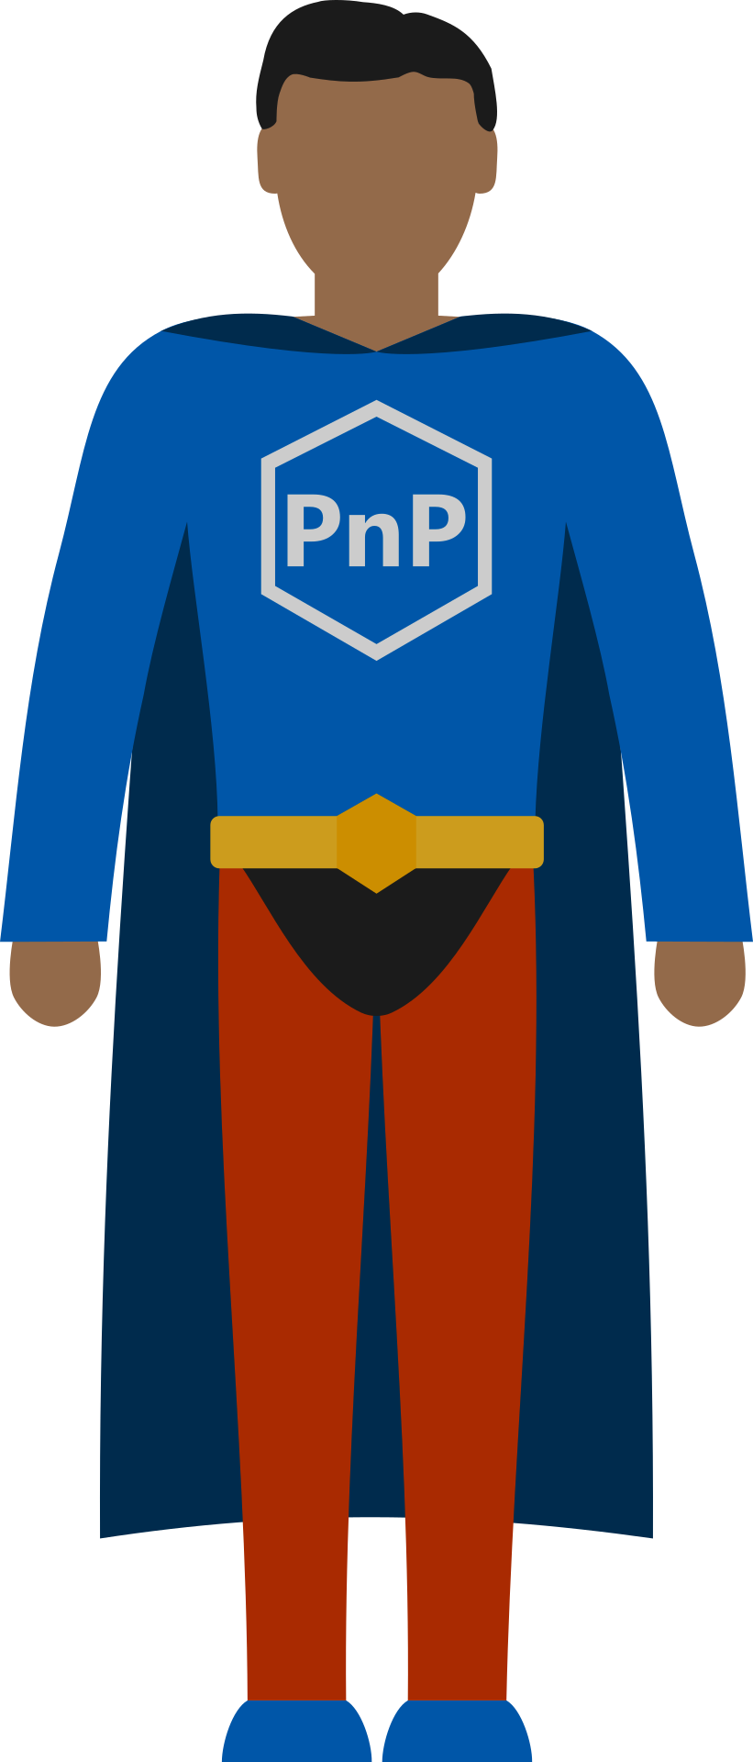
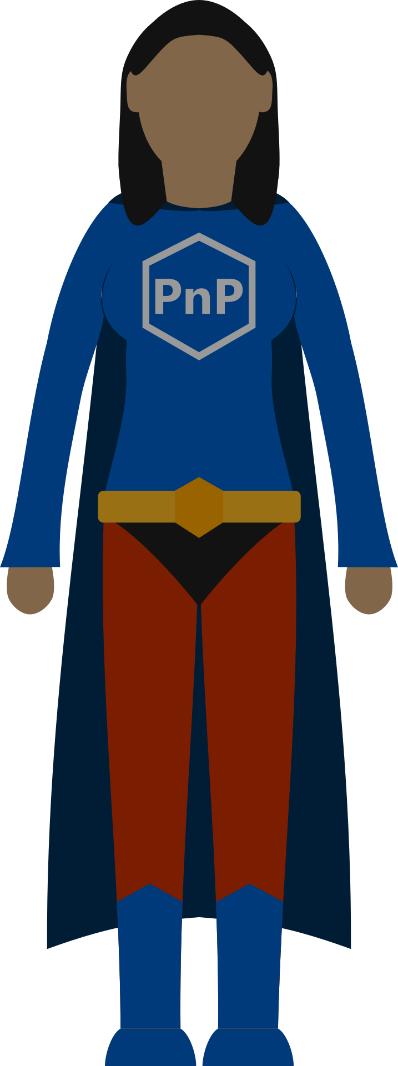
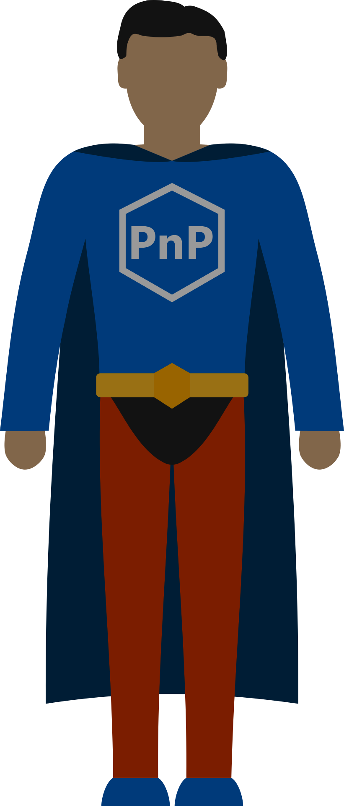
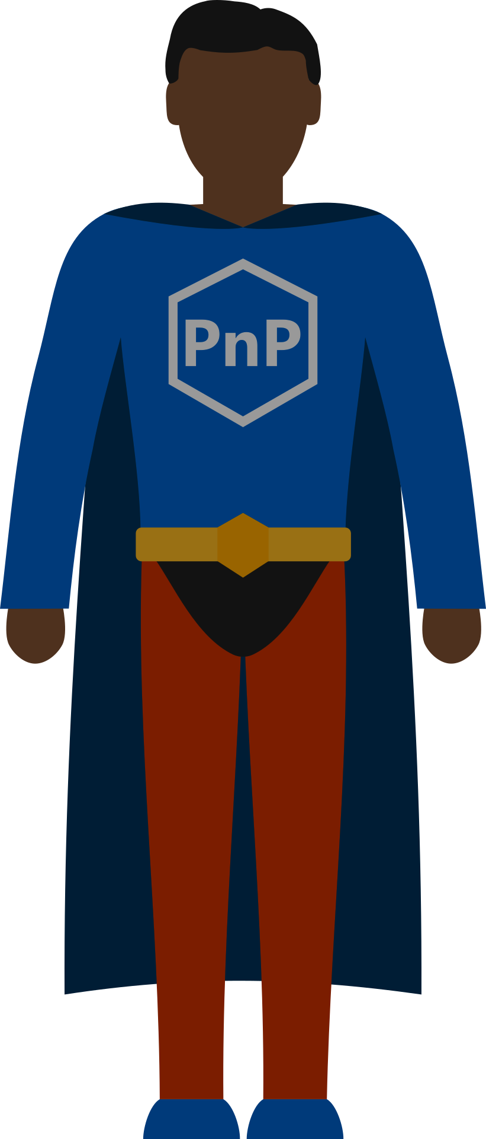
Sharing is Caring

Slide 14


Slide 15


Slide 16

aka.ms/sppnp

Slide 17
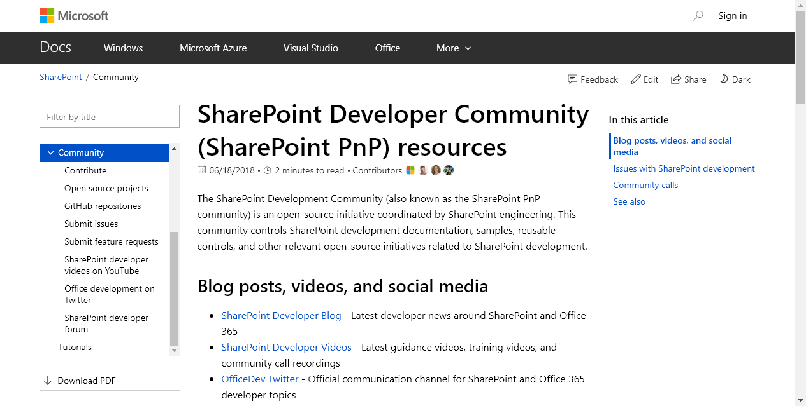

Slide 20

Documentation
Best Practices
Tutorials
Videos & Webcasts
Sample Solutions
Full Solutions
Use what makes sense
You don’t need to start at the “beginning”
PnP Guidance

Slide 21
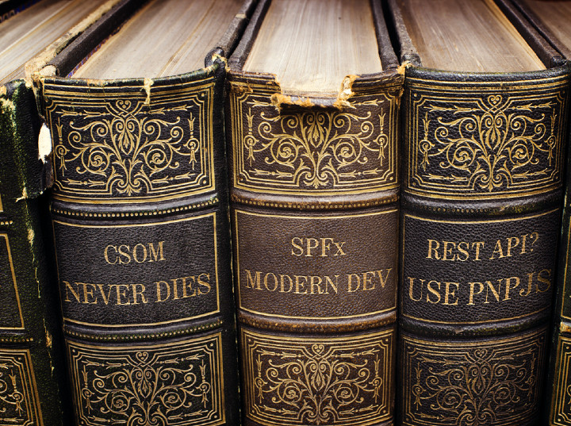
aka.ms/spdev-docs

Slide 22
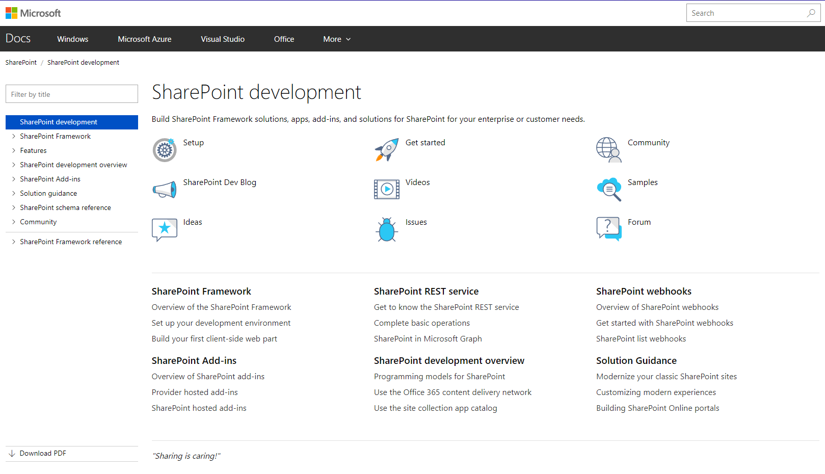

Slide 23
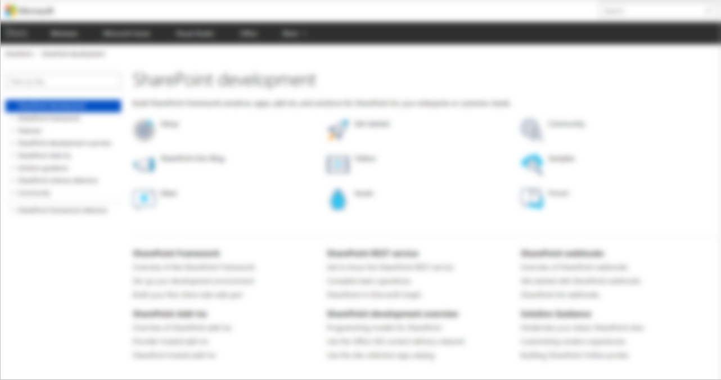
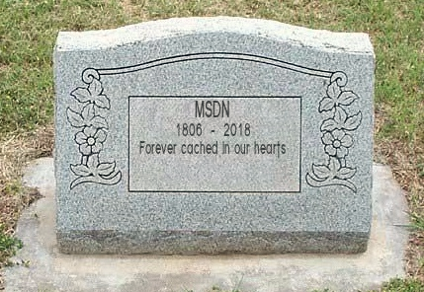
docs.microsoft.com/sharepoint
New consolidated platform
All active SharePoint development topics moved here
Content managed in GitHub
SharePoint Framework
API reference
SharePoint add-ins
Declarative customizations
Tutorials
Object Reference, etc.

Slide 24

aka.ms/spdev-videos

Slide 25
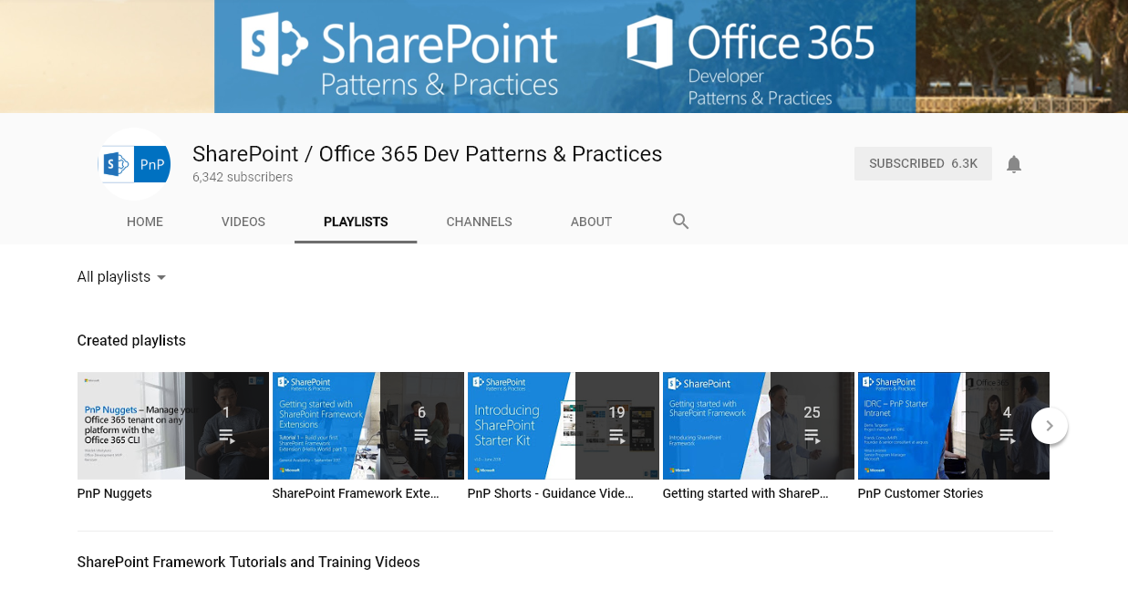

Slide 26
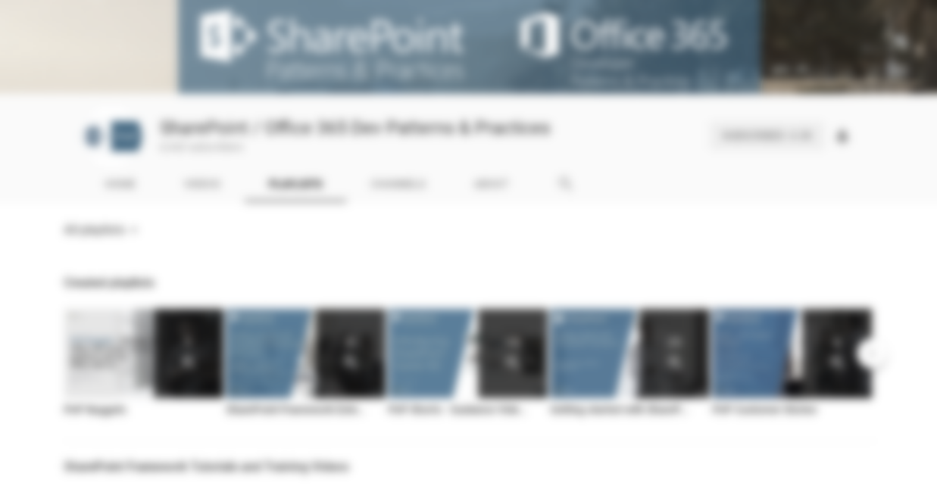


Web cast recordings
Quick Guidance Videos
Tutorial Videos
Training Videos
Community call recordings
280+ videos!
Slides
slideshare.net/sharepointpnp

Slide 27

aka.ms/spdev-samples

Slide 28
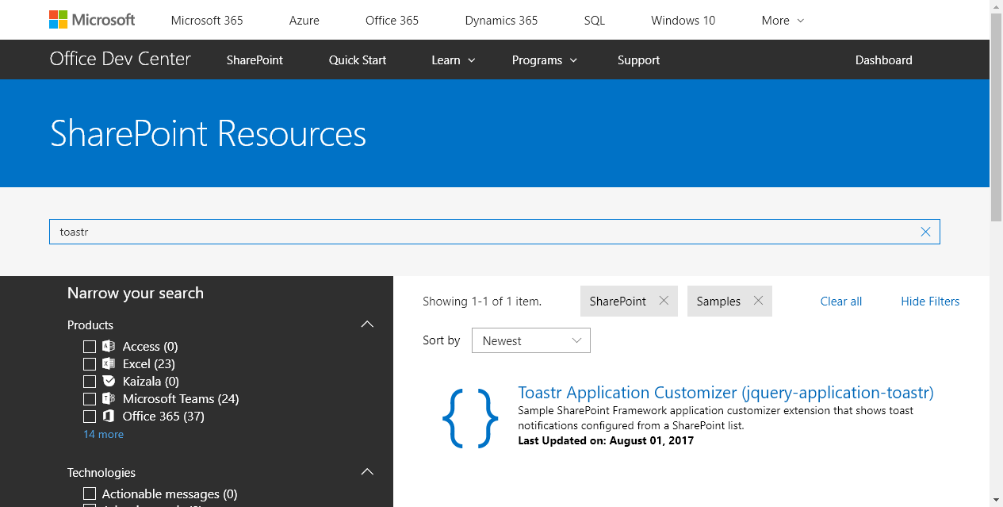

Slide 29
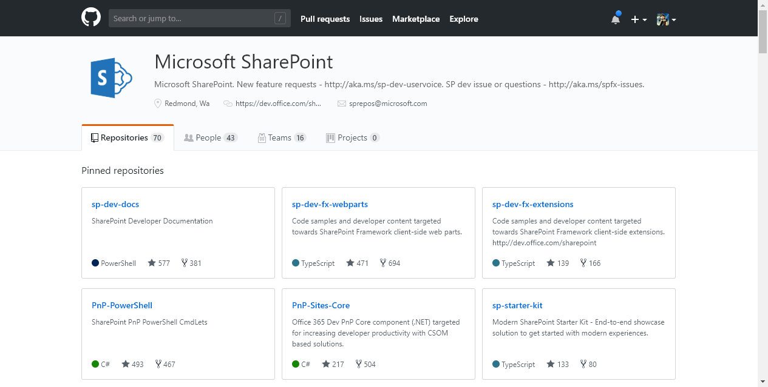



GitHub.com/SharePoint
&
GitHub.com/PnP

Slide 30


Slide 31

Demo: GitHub Basics
Notes:
Show off the Download Zip button
Navigate directly to files in Github

Slide 32


Slide 33



Tenant Administration
Remote Provisioning
Programmatic Configuration
And More
2013, 2016, O365 (2019 soon)
Works with (not replaces) SP PowerShell
Run from YOUR machine
PNP PowerShell

Slide 34
PnP-PowerShell Cmdlets
aka.ms/sppnp-powershell
340+ CmdLets
Apps (12)
Base Cmdlets (17)
Branding (20)
Client-Side Pages (9)
Content Types (9)
Diagnostic Utilities (3)
Document Sets (5)
Event Receivers (3)
Features (4)
Fields (7)
Files and Folders (18)
Information Management (6)
Lists, Views, & Items (18)
Microsoft Graph (13)
Provisioning (13)
Publishing (13)
Records Management (9)
Search (5)
SharePoint Recycle Bin (5)
SharePoint WebHooks (4)
Sites (14)
Taxonomy (17)
Tenant Administration (61)
User and Group Management (12)
User Profiles (5)
Utilities (1)
Web Parts (11)
Webs (17)
Workflows (10)

Slide 35
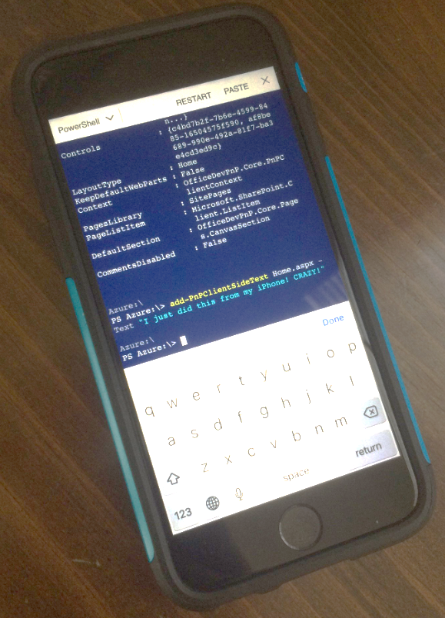
PnP-PowerShell Cmdlets
aka.ms/sppnp-powershell
340+ CmdLets
Apps (12)
Base Cmdlets (17)
Branding (20)
Client-Side Pages (9)
Content Types (9)
Diagnostic Utilities (3)
Document Sets (5)
Event Receivers (3)
Features (4)
Fields (7)
Files and Folders (18)
Information Management (6)
Lists, Views, & Items (18)
Microsoft Graph (13)
Provisioning (13)
Publishing (13)
Records Management (9)
Search (5)
SharePoint Recycle Bin (5)
SharePoint WebHooks (4)
Sites (14)
Taxonomy (17)
Tenant Administration (61)
User and Group Management (12)
User Profiles (5)
Utilities (1)
Web Parts (11)
Webs (17)
Workflows (10)
Running on an iPhone using the Azure App!
But… why?
Because it’s
AWESOME

Slide 36
Important Basic Cmdlets
aka.ms/sppnp-powershell
Cmdlet | Description | Platforms
Connect-PnPOnline | Connects to a SharePoint site and creates a context that is required for other PnP Cmdlets (Do this first) | All
Get-PnPContext | Returns a Client Side Object Model context | All
Disconnect-PnPOnline | Disconnects the context (Do this last) | All
Connect-PnPOnline https://mytenant.sharepoint.com/sites/MySite -CurrentCredentials
https://thechriskent.com/2018/02/14/using-sharepoint-pnp-powershell-modules-side-by-side-2013-2016-online/

Slide 37

Demo: PnP PowerShell
Notes:
Connect-PnPOnline https://thechriskent.sharepoint.com/sites/fun
Add-PnPClientSidePage -Name "Magic" –CommentsEnabled
Add-PnPClientSideText -Page "Magic" -Text “Yo dawg, welcome to my site"
Add-PnPClientSideWebPart -Page "Magic" -DefaultWebPartType BingMap -WebPartProperties "{pushPins:[{title:'Home Sweet Home',address:'Plainfield, IN'}],center:{latitude:39.7044,longitude:-86.3978,altitude:0,altitudeReference:-1},zoomLevel:13}"

Slide 38

Pretty much everything
(as long as there is a CSOM API)
Site Columns
Content Types
Lists
Data Rows
Pages
Custom Actions
Remote Provisioning

Slide 39


PnP Provisioning Engine
Uses the Client Side Object Model (CSOM) to provision artifacts instead of using the Feature Framework
Removes the need to use declarative XML! (mostly)
Can use the SharePoint UI to create artifacts
Creates a Template file
Easy to add to source control, move between environments, etc.
Applies as Diff
Non-Destructive – your content is safe
Can be reapplied as templates evolve

Slide 40
Remote Provisioning Supported Environments
SharePoint 2013
Minimum required version: April 2015 CU
Full functionality required version: January 2016 CU
SharePoint 2016 (2019 soon)
SharePoint Online
Best Coverage
Includes full support for SPFx Web Parts & extensions
Modern pages, Modern sites

Slide 41
Important Provisioning Cmdlets
Cmdlet | Description | Platforms
Get-PnPProvisioningTemplate | Generates a provisioning template from a web | All
Apply-PnPProvisioningTemplate | Applies a provisioning template to a web | All
Connect-PnPOnline https://mytenant.sharepoint.com/sites/MySite -CurrentCredentials
Get-PnPProvisioningTemplate -Out MyTemplate.xml
Disconnect-PnPOnline
PowerShell NOT required, can also be done from .NET

Slide 42

Site Designs & Remote Provisioning
O365 Modern Site Provisioning
JSON Schema
Add Lists & Fields
Add Navigation Links
Set Theme and Logo
Join Hub Site
And More!
Trigger a Flow
Flow
Http Call
Azure Queue
Azure Function
Apply Template
Additional Configuration
https://docs.microsoft.com/en-us/sharepoint/dev/declarative-customization/site-design-pnp-provisioning

Slide 43

Demo: Remote
Provisioning
Notes:
Create list on Model site with 1 or 2 columns
Create new Comm site Target, go to site contents
Connect-PnPOnline https://thechriskent.sharepoint.com/sites/Model
Get-PnPProvisioningTemplate -Out "MyTemplate.xml" -Handlers Lists
Disconnect-PnPOnline
Open MyTemplate.xml
Connect-PnPOnline https://thechriskent.sharepoint.com/sites/Target
Apply-PnPProvisioningTemplate -Path "MyTemplate.xml" -Handlers Lists
Disconnect-PnPOnline

Slide 44

Demo: Site Design with
Remote Provisioning
Notes:
Create Site
Show MySpecialTemplate.xml
Show Site Design JSON

Slide 45


Fluent API
Batching
Caching
The best way to access the REST API via JS
PnPJS

Slide 46
Choose your functionality (Available as npm packages and via CDN)
@pnp/common
@pnp/config-store
@pnp/graph
@pnp/logging
@pnp/nodejs
@pnp/odata
@pnp/pnpjs
@pnp/sp
@pnp/sp-addinhelpers
Rollup (mimics sp-pnp-js)
Fluent API for SharePoint REST
Traditional Approach: string concatenation
api/web/lists/getbytitle(‘Things’).items?$select=Title,Author/Id$expand=Author&$top=50

Slide 47

PnPJS: Fluent API
Traditional Approach: string concatenation
api/web/lists/getbytitle(‘Things’).items?$select=Title,Author/Id$expand=Author&$top=50

Slide 48

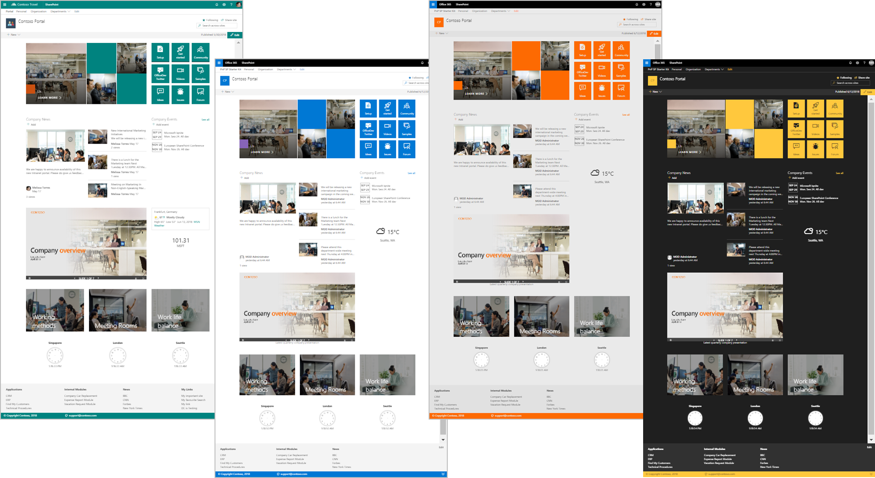
End-to-End modern experience
Multiple SPFx webparts & Extensions
Site Designs & Themes
Deployment Scripts
SP Starter Kit

Slide 49

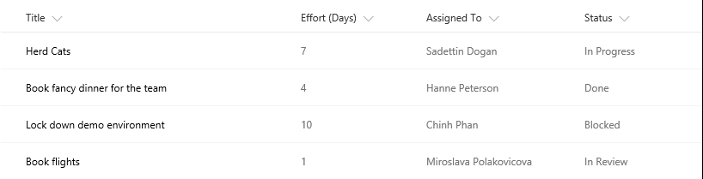
The Modern Listview
Responsive
Fancy
Boring
No XSLT
No Calculated Column Trickery

Slide 50


Dapper
The Modern Listview

Slide 51

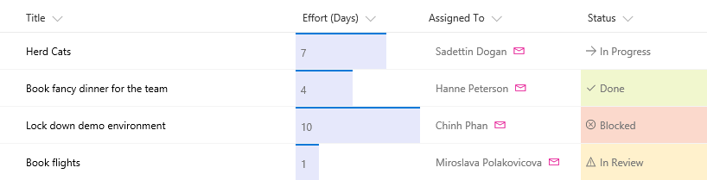

Slide 52
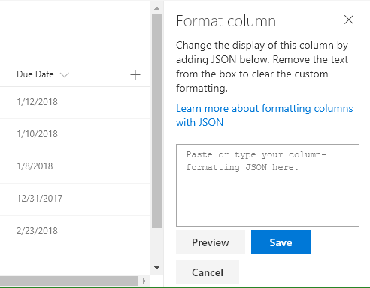
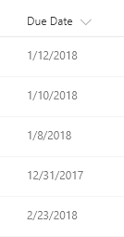

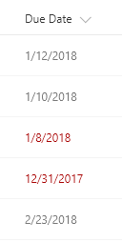



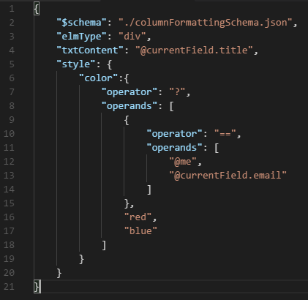

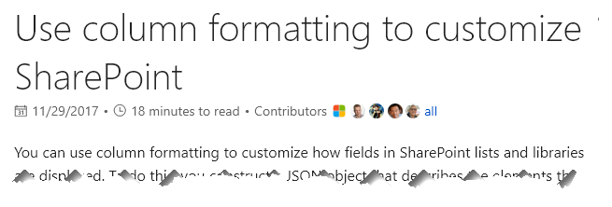




Todd
the Hero
Sad

Slide 53
Formerly Column Formatter
List Formatter Easy editor for modern list view Formatting
Official Update Release Next Week!
github.com/SharePoint/SP-Dev-Solutions/tree/master/Solutions/ColumnFormatter

Slide 54
Demo: List Formatter

Slide 55


Slide 56

Contribution Opportunities
Join the calls and talk in the chat
Add an idea to UserVoice
Fix the documentation
Report an Issue
Fix some code
Present on the call
Add a sample

Slide 57

Thank you for your assistance within last month!
Alex Terentiev (SharePointalist) - @alexaterentiev
andreasblueher alias - andreasblueher
Andrew Connell (Voitanos) - @andrewconnell
Andrew Koltyakov (ARVO Systems) - @andrewkoltyakov
Asish Padhy - AsishP
berosk alias - berosk
Beau Cameron - @Beau__Cameron
Chris Kent (DMI) - @theChrisKent
ChrispyBites alias - ChrispyBites
David Warner II (Catapult) - @DavidWarnerII
Derek Noonan - noonand
Edin Kapic - @ekapic
Elio Struyf - @eliostruyf
Erwin van Hunen (Rencore) - @erwinvanhunen
Eric Overfield (PixelMill) - @EricOverfield
Eric Shupps - @eshupps
Franck Cornu (aequos) - @FranckCornu
Fredrik Thorild (Sogeti) - fthorild
Giuliano De Luca - @giuleon
Hilton Giesenow (Experts Inside) - HiltonGiesenow
Hugo Bernier - @bernierh
jdonajkowski alias - jdonajkowski
Joel Rodrigues (CPS) - joelfmrodrigues
John Benson - john88benson
Kim Damsleth (Puzzlepart) - damsleth
Lars Lynch - tklarslynch
Laurent Sittler (Exakis) - @laul0_68
Luis Mañez - @luismanez
Luis Valencia - @levalencia
Mark Powney - mpowney
Martin Dubec - cebud
Michael Schau (WorkPoint A/S) - @SchauDK
Mikael Svenson (Puzzlepart) - @mikaelsvenson
Ole Kristian Mørch-Storstein (Puzzlepart) - okms
Ole Martin Pettersen (Puzzlepart) - olemp
Paolo Pialorsi (PiaSys.com) - @PaoloPia
Paul Pascha (Wortell) - @paulpascha
Paul Schaeflein - @paulschaeflein
Radi Atanassov (OneBit Software) - @RadiAtanassov
Richard Priddy - RichardPriddy
Russell Gove - russgove
Sebastian Mattar - sebastianmattar
Sergei Sergeev - @sergeev_srg
Simon-Pierre Plante (SPP Technologies) - spplante
Spencer Harbar (ClearPeople) - @harbars
Stefan Bauer (n8d) - @StfBauer
Stephen Reilly - itsknob
svarukala alias - svarukala
Vardhaman Deshpande (Content and Code) - @vrdmn
Velin Georgiev - @velingeorgiev
Vincent Biret (2toLead) - @baywet
Vipul Kelkar (Rapid Circle) - vipulkelkar
Waldek Mastykarz (Rencore) - @waldekm
westleyMS alias - westleyMS
Yannick Plenevaux - @yp_code

Slide 58


















Companies involved with June 2018 release
Companies which provided support for PnP initiative by allowing their employees to contribute to our open source projects
These are companies, from where we got approval to use their logo
You contributed and your company is not here? – Send us an email with your permissions and logo

Slide 59
Demo: GitHub Contributions
Notes:
Fork button
Edit button
Submit Pull Request

Slide 60


Bi-Weekly
SP General Development
aka.ms/sppnp-core-sig-call
PowerShell, Provisioning, CSOM
Next Call: Thursday, 8/9
Bi-Weekly
SharePoint Framework
aka.ms/sppnp-js-sig-call
SPFx, PnP JS Core
Next Call: Thursday, 8/2
Monthly
Community Calls
aka.ms/sppnp-call
Monthly Summary
Next Call: Tuesday, 8/13

Slide 61



Official Blog
dev.office.com/blogs
Twitter
@OfficeDevPnP
Tech Community
aka.ms/sppnp-community

Slide 62

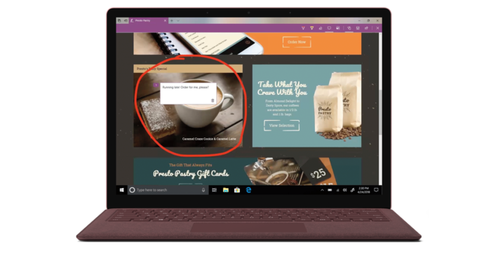
EVAls / PRIZES
Bring all items to the 6th Info Desk
Bingo Cards = how you win prizes at the end of the event.
The cards must be stamped by ALL the Sponsors by the last session (4pm)
Fill out speakers evaluations (located in the front of the rooms
Fill out the event evaluations
Xbox One X
Surface Go
And more …

Slide 63


Beer Authority
300 W 40^{h} St
[across the street]
Join us for a round of drinks
http://www.beerauthoritynyc.com

Slide 64
SharePoint Framework 1.6 - Current plan – ETA: end of July 2018
Schedule and content is subject to change
Planned to get released by end of July – 1.7 in Ignite timeframe
Tenant wide deployment of SharePoint Framework Extensions
GA of Graph and 3rd party API calls from SharePoint Framework
GA of Dialog Framework (still in beta)
Support for React 16
Preview of socket.io
SharePoint 2019 support (choosing the right version)
Other “things”… some surprises always there…

Slide 65
SharePoint 2019 – Dev Platform
Yes
No
Modern pages
Modern sites – Modern team and communication site
SharePoint Framework Extensions
Webhooks
Asset packaging (no CDN)
Column formatting
(Tenant scoped deployment)
(ALM APIs)
Site Designs
Hub sites
Site collection app catalog
“Tenant” properties
Preliminary plan, subject to change
SharePoint 2019 SharePoint Framework 3rd party version will be 1.4

